Slide 1
Lung segmentation with u-net
On Pulmonary Chest X-Ray
Defect Detection dataset
By Anurodh Raina

Slide 2
Data Collection
The dataset was sourced from kaggle repository and is available at : https://www.kaggle.com/datasets/nikhilpandey360/chest-xray-masks-and-labels/data
It was easily downloaded through the API and the size was around 10GB.
Image parameters:
-­‐ Format: PNG
-­‐ Image size is 4020 x 4892, or 4892 x 4020.
-­‐ The pixel spacing in vertical and horizontal directions is 0.0875 mm.

Slide 3
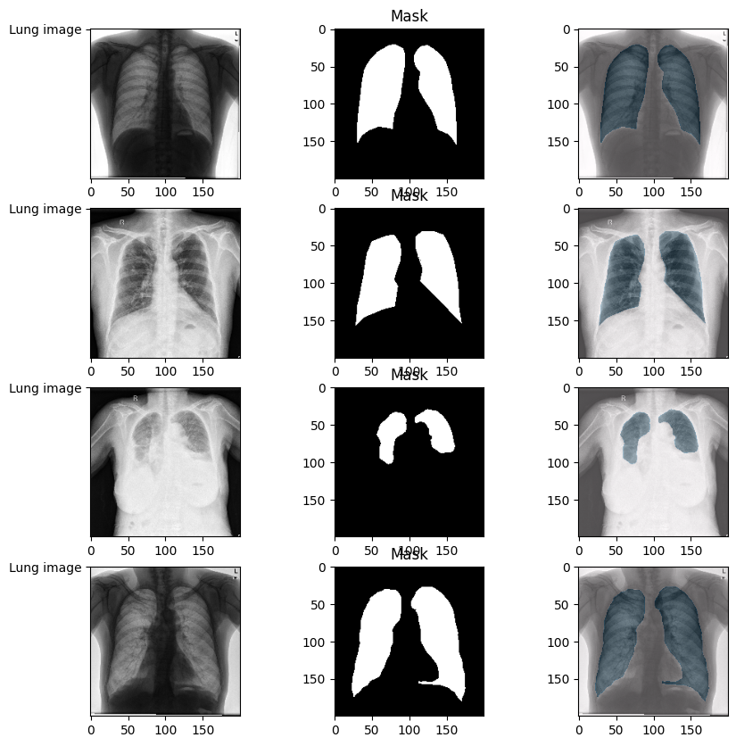
Data Overview
Some of the
sample images
from the dataset.
Data is well
masked.

Slide 4
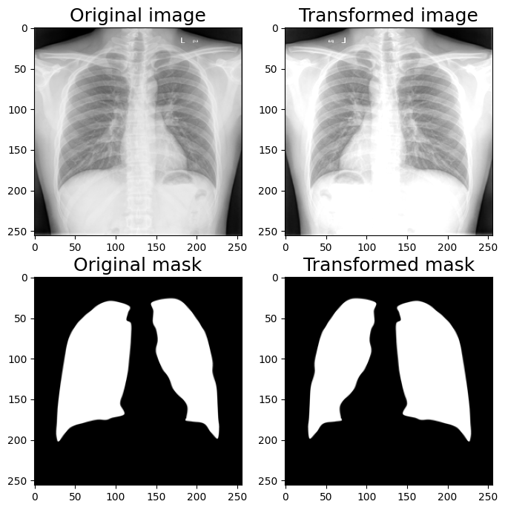
Data Processing
Conversion to grayscale
Resizing to 256x256
Convert and store to array
Augment and create more
images

Slide 5
Data Processing
Before augmentations 500 valid images and masks were present
Augmentations helped double the size to a 1000 images and mask.
Albumentations library was used for augmentations.

Slide 6
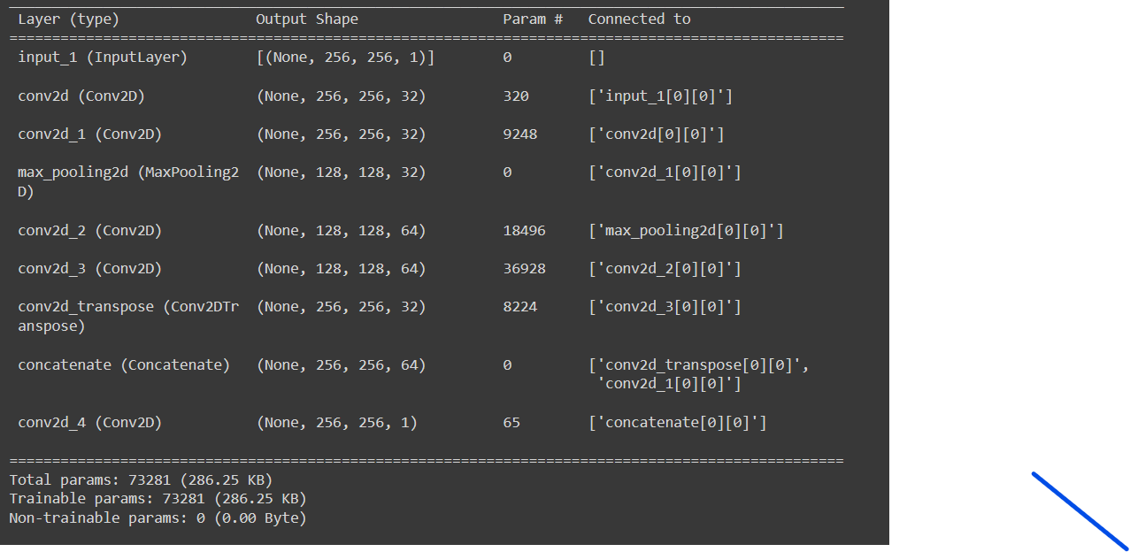
Model Architecture
Classic U-net with custom layers and filters.
Less layers for less complex dataset

Slide 7
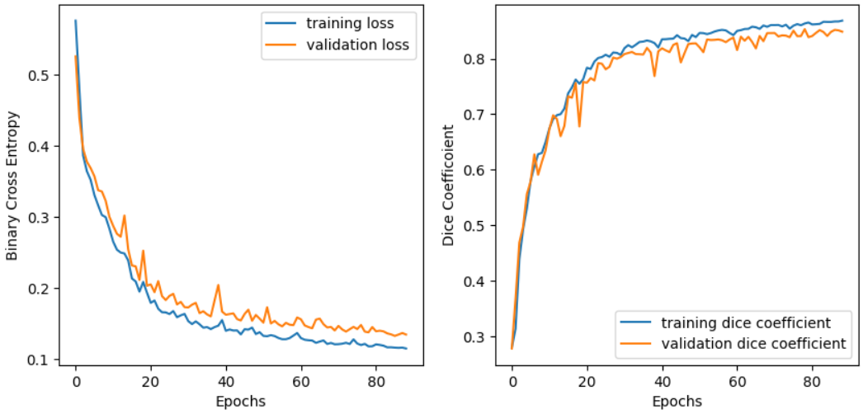
Training and Validation
Metrics for validation:
Mean IoU
Dice Coefficient

Slide 8
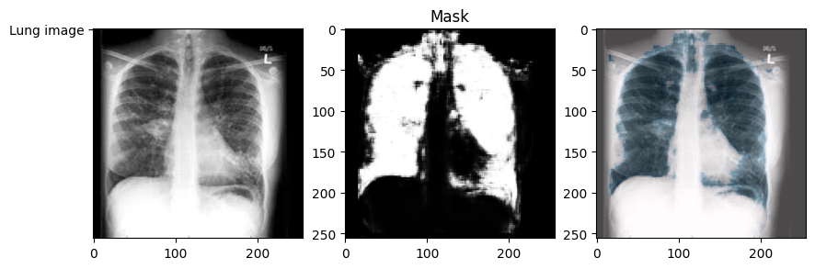
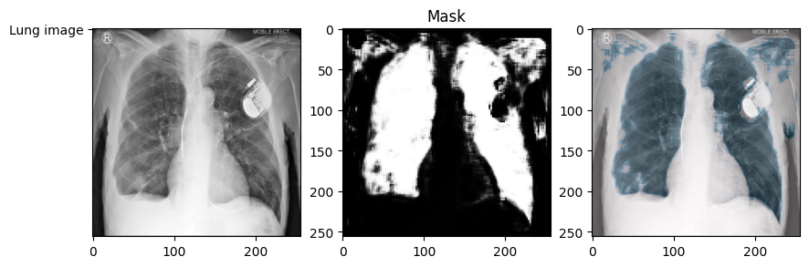
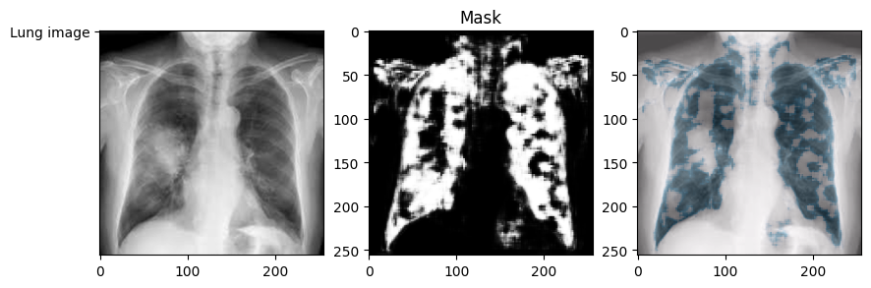
Output

Slide 9
Conclusion
Barriers faced and what else could have been done:
Realizing how adjustment to filters and layers affect the spatial information in model training and output.
Time bound challenge.
More set of augmentations leading to a more complex model.
Dice coef vs Mean IoU

Slide 10
Modules used
Numpy
Tensorflow, Keras
Albumentations
PIL
Pandas
TQDM
OS
Matplotlib

Slide 11
References
https://stackoverflow.com/questions/42883547/intuitive-understanding-of-1d-2d-and-3d-convolutions-in-convolutional-neural-n
https://albumentations.ai/docs/examples/example_kaggle_salt/
https://www.kaggle.com/gzuidhof/data-science-bowl-2017/full-preprocessing-tutorial
scaling because floating values are required: https://www.youtube.com/watch?v=RaswBvMnFxk&list=PLZsOBAyNTZwbR08R959iCvYT3qzhxvGOE&index=6
how 2d CONV if input is 3d: https://stackoverflow.com/questions/42883547/intuitive-understanding-of-1d-2d-and-3d-convolutions-in-convolutional-neural-n
https://wiki.cancerimagingarchive.net/pages/viewpage.action?pageId=1966254#19662548794a4ebe75f4cc6897002fabb3d2d4a
https://www.kaggle.com/code/stpeteishii/chest-x-ray-unet

